Slide 1
Results

Slide 2
Goal
Report findings of study in context of primary research question
Presented in logical sequence without bias or interpretation
Effective results section presents findings by solely stating facts
Reserves interpretation for discussion section

Slide 3
Goal
Factual statements supported by evidence. Short and sweet without excess words
Present representative data rather than endlessly repetitive data
Discuss variables only if they had an effect (positive or negative)
Use meaningful statistics
Avoid redundancy. If it is in the tables or captions you may not need to repeat it

Slide 4
Structure
Present results in logical order prioritizing presentation in order of complexity
Univariate→ Bivariate→ Multivariate→Higher Order
Note that logical order may sometimes deviate from chronological order
Number tables and figures separately beginning with the number one.
Paragraphs should flow in similar manner
Topic sentence
Presentation of measure of association and measure of certainty (OR [95%CI])
Keep outcome with its data

Slide 5
Descriptive Analysis
”Help put study into context”
Seeks to describe analytic population from which you are making inferences

Slide 6
Main Analysis
COME Back

Slide 7
Secondary Analysis
Secondary analysis:
Also sometimes referred to as sensitivity analysis.
Focuses on secondary exposure, secondary outcomes or higher order models (heterogeneity, trends etc.)

Slide 8
Effect Measure Modification
In main analysis of the primary association (A) and primary outcome (Y) we are interested in understanding the way that the distribution of the outcome (Y) changes given the presence of the association (A)
In other words if we are looking at the average level of phenols at a given food security level we would say:
E[Y=BPA|A=Food Security]
If we adjust for additional variables (i.e confounders) we would say:
E[Y=BPA|A=Food Security, L=Confounders]

Slide 9
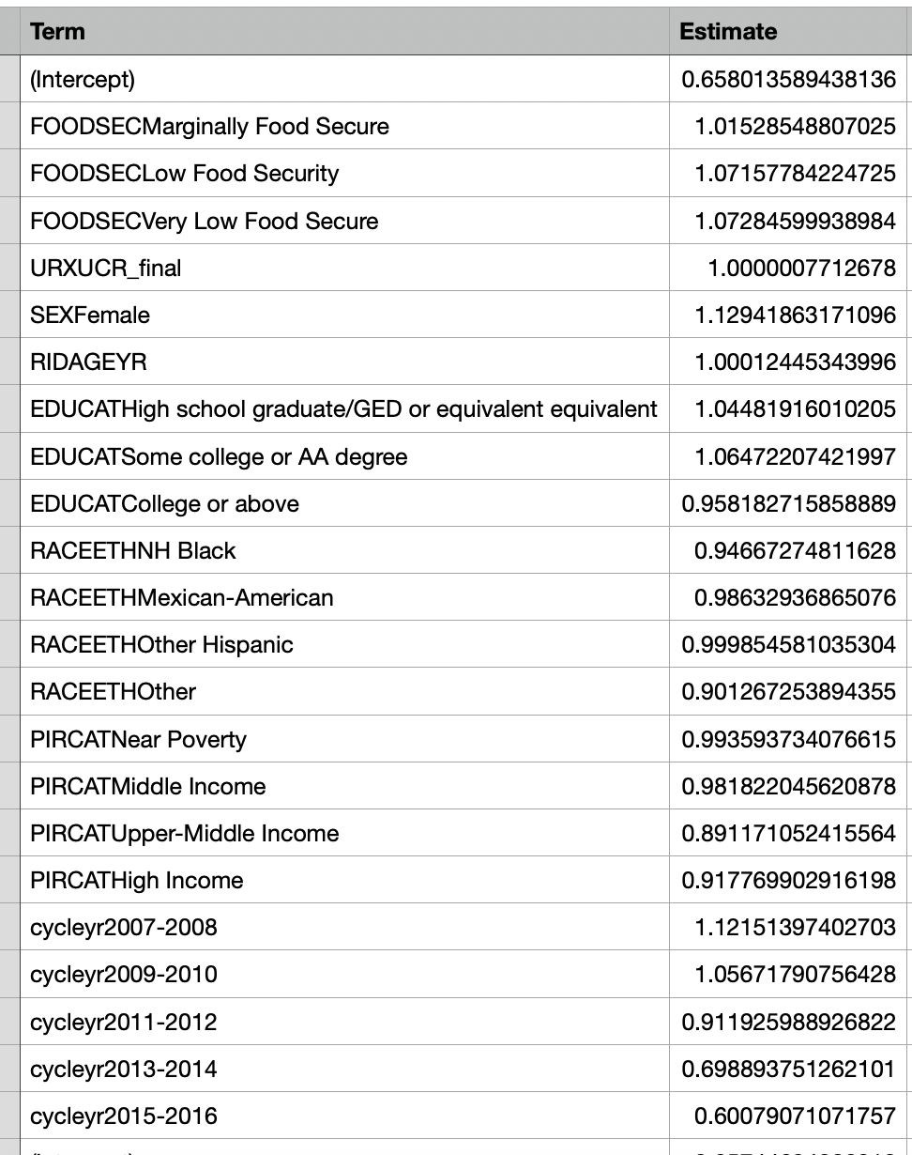
Effect Measure Modification
As we discussed we would interpret this as the expected value of phenols, given a changing level of food security is a given number, x ng/mL
In the case of a categorical variable, we would compare each respective estimated level to the reference value

Slide 10
Effect Measure Modification
When we are dealing with effect measure modification we want to look at the marginal association (that which we estimate in the entire population) within subgroups of a variable we believe that association may be stronger or weaker
We refer to this as an effect modifier.
That is that the effect of an exposure, A on the outcome, Y, is modified by X (effect measure modifier)
In the presence of effect measure modification (EMM) the magnitude of the association can vary across levels of that variable
Ex: Sex (female, male)

Slide 11
Effect Measure Modification
EMM is an intrinsic phenomenon we cannot and do not seek to eliminate
In other words EMM is not an internal validity issue (i.e bias such as confounding or selection bias)
It is an external validity factor (i.e generalizability)
Again it is distinct from confounding, although both ultimately become variables we adjust for but for different reasons

Slide 12
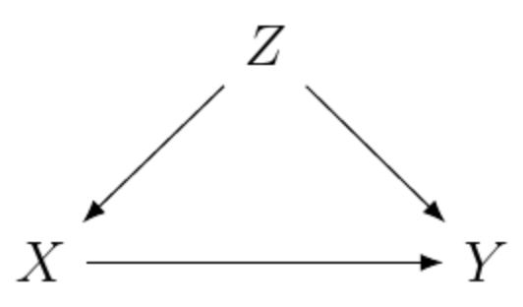
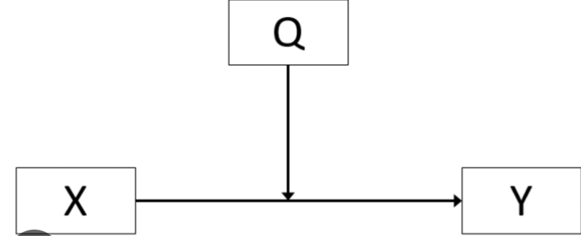
Effect Measure Modification
EMM is an intrinsic phenomenon we cannot and do not seek to eliminate
In other words EMM is not an internal validity issue (i.e bias such as confounding or selection bias)
It is an external validity factor (i.e generalizability)
Again it is distinct from confounding, although both ultimately become variables we adjust for but for different reasons

Slide 13
Effect Measure Modification
EMM is scale dependent: additive, multiplicative
Presentation of results depends on scale.
Present relative risks (RRs), Ors or risk differences (RDs) with confidence intervals (Cis) for each stratum of A and X with a single reference category.
Amongst females: the association of A=2 vs A1 was X% higher or lower
Amongst males: the association of of A=2 vs A1 was X% higher or lower
The association was stronger amongst females.

Slide 14
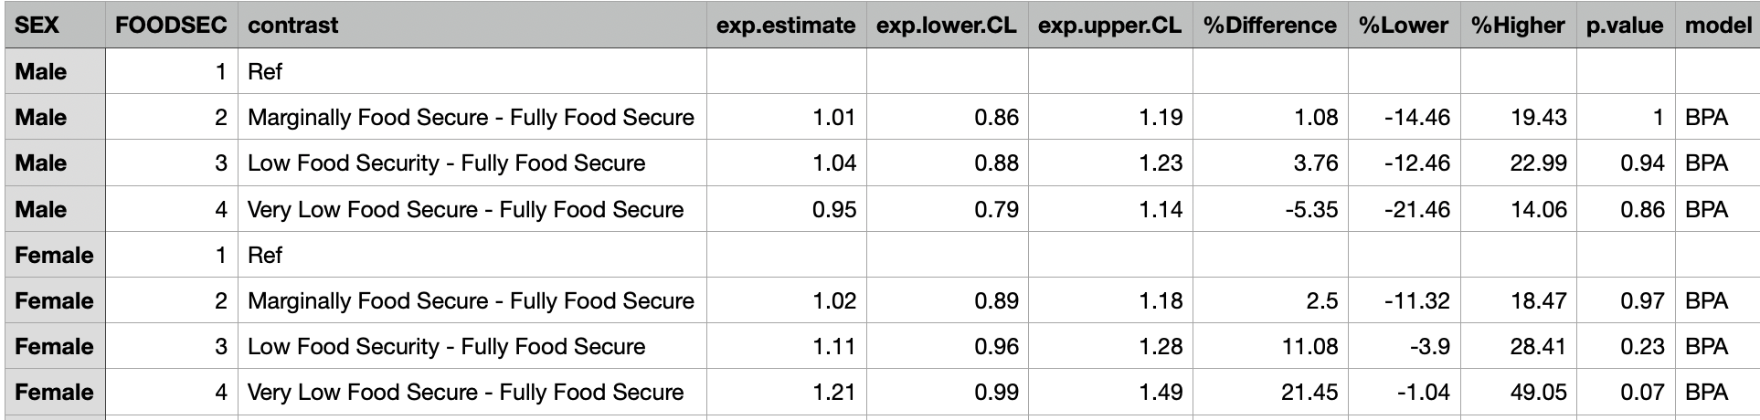
Practice

